Slide 1

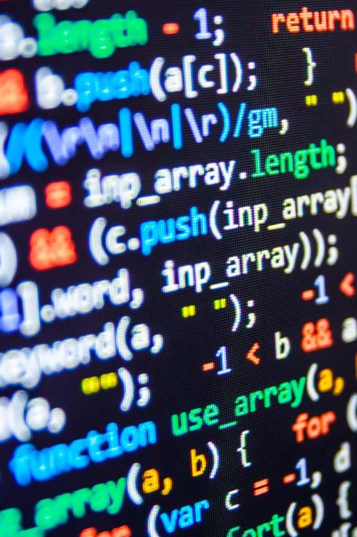
Conditional statements in C language
Learn about the power of conditional statements in C language and how they are essential in programming to control the flow of execution based on different conditions.

Slide 2

What are Conditional Statements?
Conditional statements provide a way for the program to make decisions and choose different paths of execution based on certain conditions. They are fundamental building blocks in programming languages like C.

Slide 3

Why are they important in programming?
Conditional statements allow programs to be dynamic and responsive by executing different sets of instructions based on different input values or conditions. This helps in creating more efficient and flexible code.

Slide 4

If statements
If statements allow the program to perform certain actions only if a certain condition is true. The structure consists of the keyword "if" followed by a condition and a block of code enclosed in curly braces.

Slide 5

If-else statements
If-else statements provide a way to execute one set of instructions when a condition is true and another set when the condition is false. This is useful when there are two possible outcomes for a given condition.

Slide 6
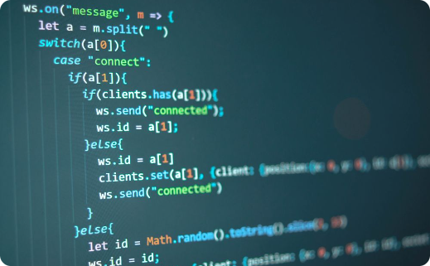


Examples of if-else statements
Example 1
Example 2
Example 3
Determine if a number is positive, negative, or zero and display an appropriate message.
Find the maximum of two numbers and display the result.
Determine if a character is a vowel or a consonant.

Slide 7
Nested if-else statements
Nested if-else statements allow for multiple levels of conditions and provide a way to handle more complex decision-making scenarios. They can be used when there are multiple possible outcomes for a given condition.

Slide 8

Examples of nested if-else statements
1
Example 1
Determine if a year is a leap year, taking into account multiple conditions.
2
Example 2
Calculate the final grade of a student based on multiple criteria.
3
Example 3
Determine the type of a triangle based on the length of its sides.

Slide 9

Switch statements
Switch statements provide an alternative way to handle multiple conditions by using the value of a variable as an input and executing different code blocks based on the different possible values of the variable.

Slide 10
Examples of switch statements
Example 1
Determine the day of the week based on a given number from 1 to 7.
Example 2
Perform different calculations based on the selected operation (+, -, *, /).
Example 3
Display the name of a month based on a given number from 1 to 12.

Slide 11
Conclusion
Conditional statements are essential in programming, providing the ability to make decisions and control the flow of execution. Understanding their syntax and usage is fundamental for aspiring programmers.
By mastering conditional statements, you'll be able to create more dynamic, flexible, and powerful programs. Keep exploring and practicing to solidify your knowledge and become an expert coder!

